Slide 1
Porting EVR to AMD Xilinx Zynq Ultrascale+
Timing Workshop
EPICS Collaboration Meeting
Rutherford Appleton Laboratory
April 11, 2025

Slide 2
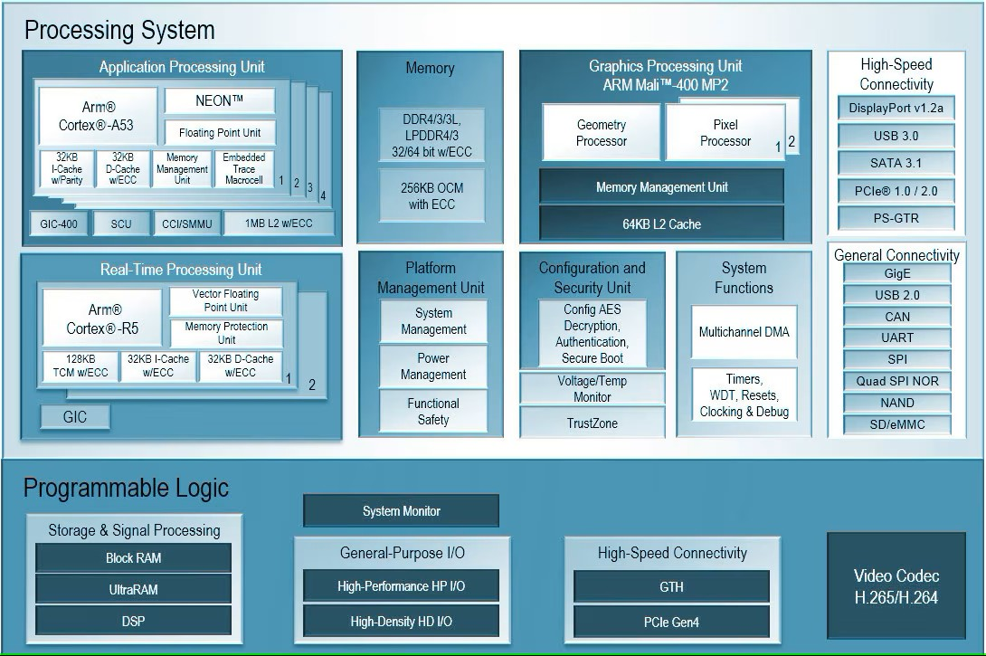
AMD Xilinx Zynq Ultrascale+
PS (Processing System)
  Powerful MPSoC
  Dedicated I/O pins
  Runs independently of PL
  Peripherals include GigE, PCIe, I2C, etc.
  Runs Linux
PL (Programmable Logic)
  FPGA
  AXI connectivity to PS
  High-Speed GTH transceivers

Slide 3
AMD Xilinx Zynq Ultrascale+ Booting Process
FSBL (First Stage Boot Loader)
  Initialization
  Boot device initialization
  Partition loading
  Handoff
U-Boot
Linux
FPGA Configuration in Linux
Documentation somewhat hard to find and digest

Slide 4
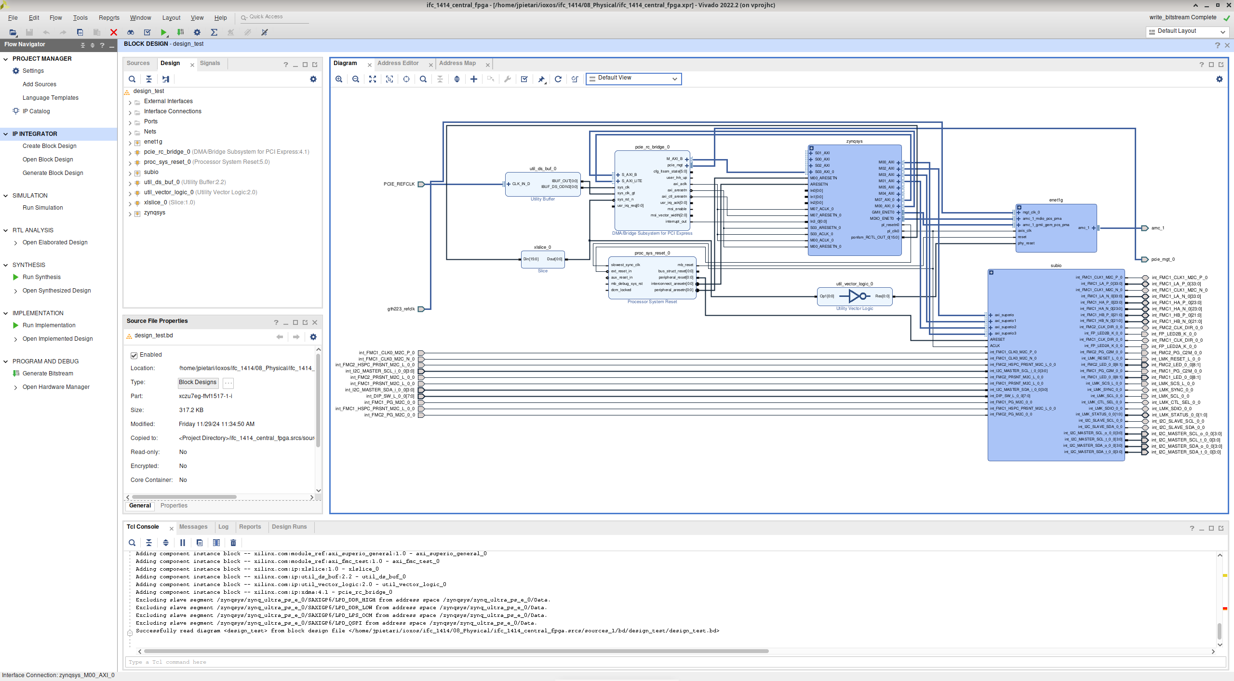
AMD Xilinx Zynq Ultrascale+ in Vivado
Block diagram
Not version control friendly
Portability across Vivado versions
Extract Block Design
  TCL script to regenerate block design

Slide 5
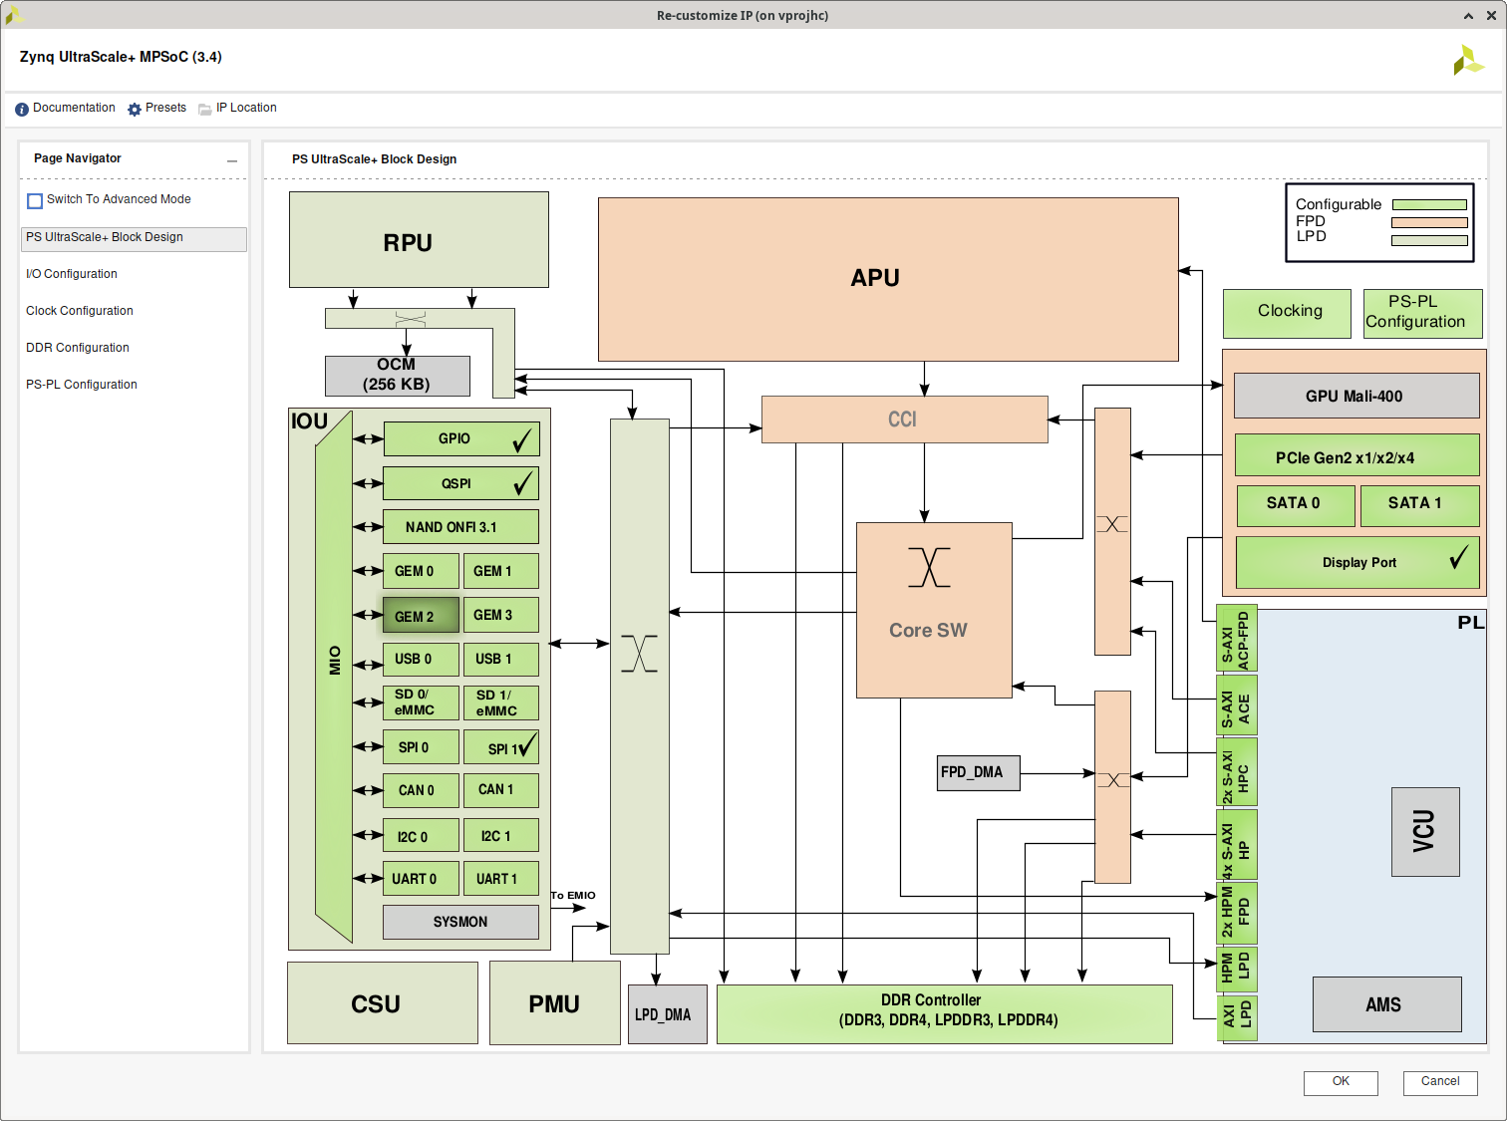
AMD Xilinx Zynq Ultrascale+
IP core generator
.xci files text based but not version control friendly nor portable across Vivado versions
Extract TCL from log file

Slide 6
Version Control for FPGA source code
HDL (VHDL/Verilog)
Instantiation in HDL
TCL scripts for IP cores
TCL scripts for project setup and implementation
Constraints in human readable text files
No block designs/GUI tools needed

Slide 7
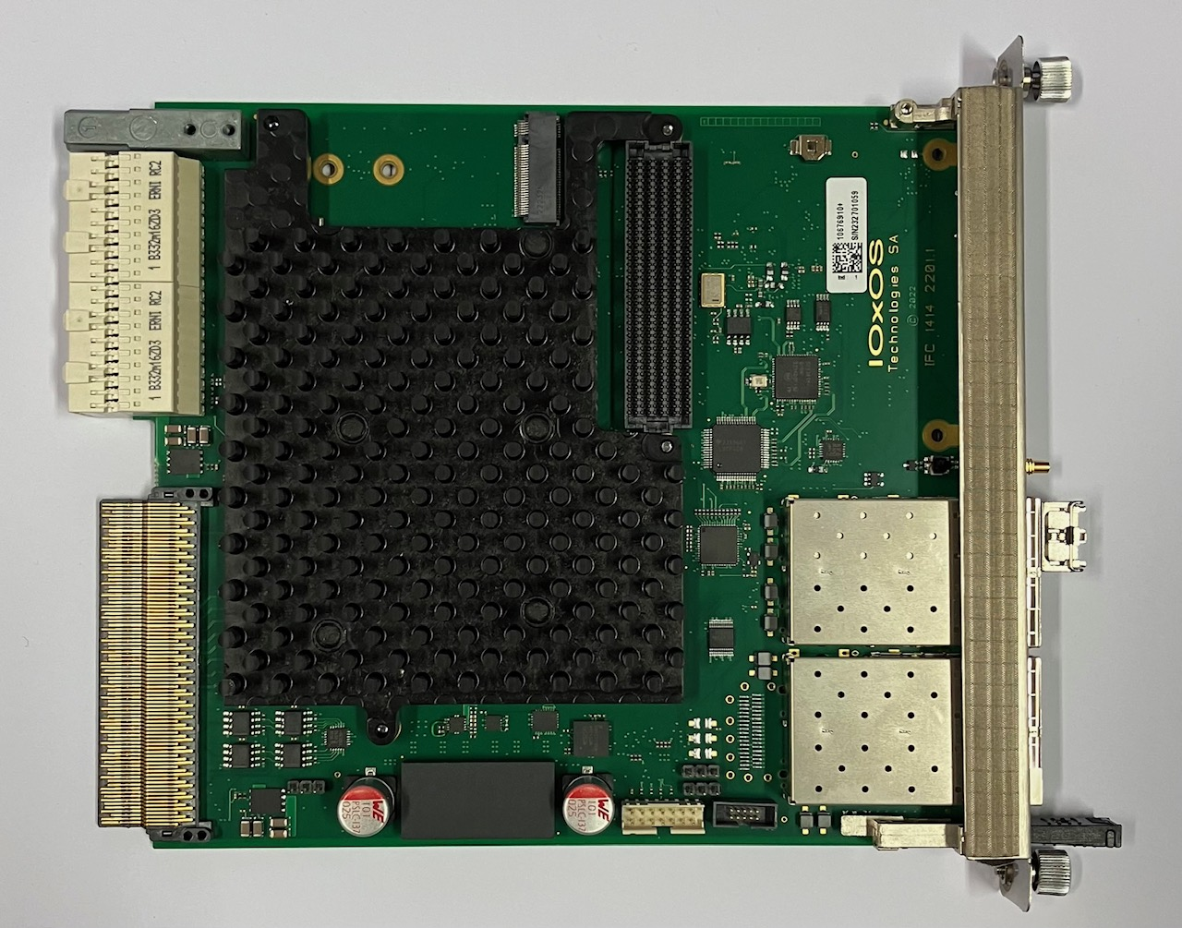
IOxOS IFC_1414
Zynq Ultrascale+ mTCA.4 Processor AMC
Single VITA 57.1 FMC slot
SFP+ slots in front panel
Class D1.2 RTM interface
Si5341B clock generator
  Reference clock for EVR
LMK04616ZCR clock cleaner for system clocks
  Cannot be used for EVR clock cleaning

Slide 8
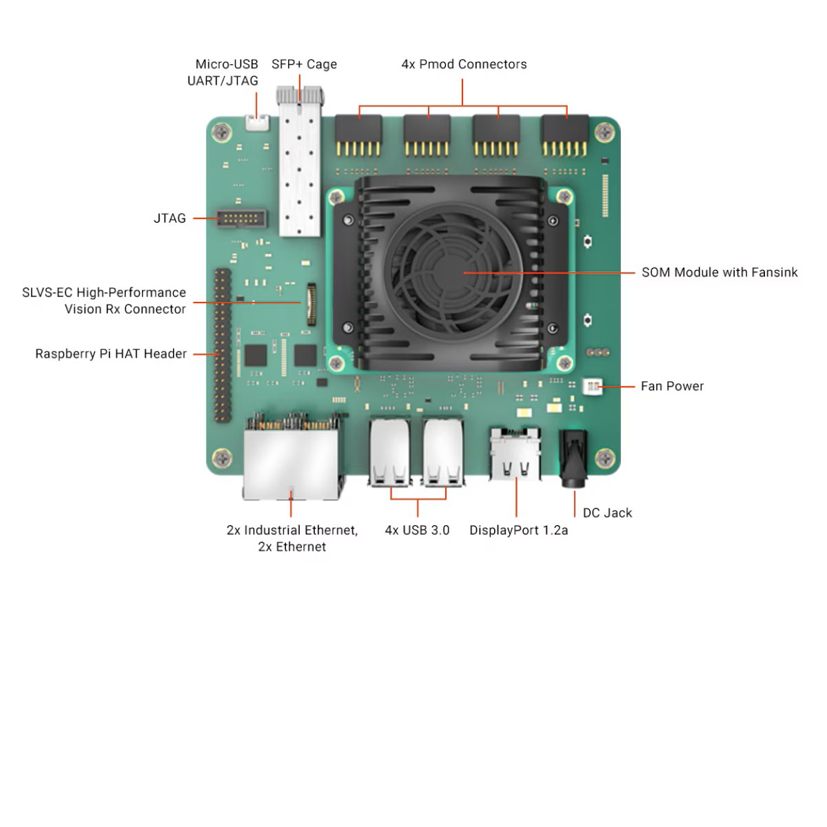
Xilinx KR260 Robotics Stater Kit
Lots of I/O
SFP cage for transceiver
Two fixed GTH reference clocks
  156.25 MHz and 74.25 MHz

Slide 9
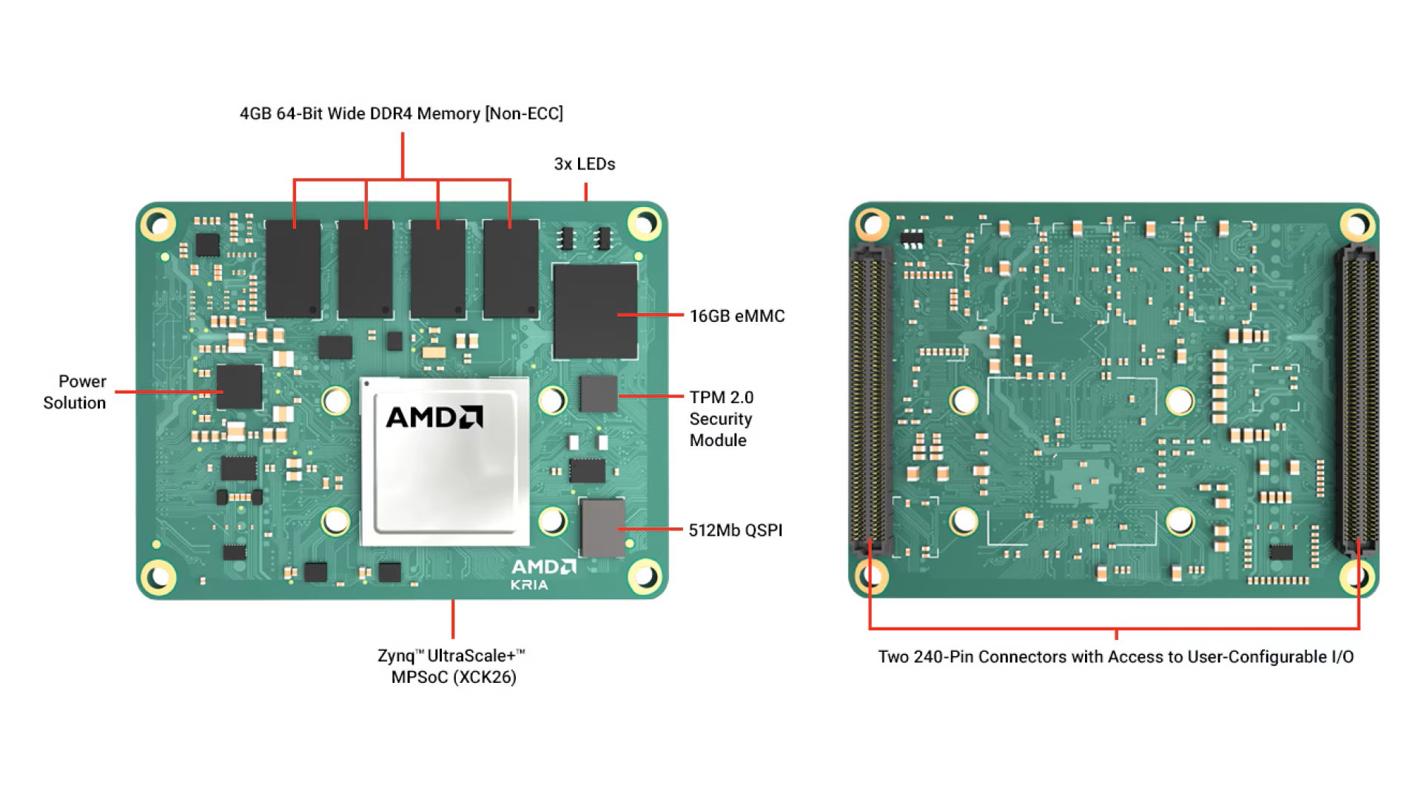
Xilinx KRIA K26 SOM
General Specifications
Dimensions (with heat spreader)
  77 mm x 60 mm x 11 mm
Application Processor
  Quad-core Arm® Cortex®-A53 MPCore™ up to 1.5 GHz
Real-Time Processor
  Dual-core Arm Cortex-R5F MPCore up to 600 MHz
Graphics Processing Unit
  Mali™-400 MP2 up to 667 MHz
Video Codec Unit (VCU)
  1 - up to 32 streams (total resolution ≤ 4Kp60)
Trusted Platform Module (TPM)
  Infineon 2.0
Memory On-Chip*
  26.6 Mb On-Chip SRAM
Memory On-SOM
  4GB 64-bit DDR4 (non-ECC) and 16 GB eMMC
High-Speed PS Connectivity (GTR)
  PCIe® Gen2 x4, 2x USB3.0, SATA 3.1, DisplayPort™, 4x Tri-mode Gigabit Ethernet
General PS Connectivity (MIO)
  2xUSB 2.0, 2x SD/SDIO, 2x UART, 2x CAN 2.0B, 2x I2C, 2x SPI, 4x 32b GPIO
GTH 12.5 Gb/s Transceivers
  4 (PCIe Gen3 x4, SLVS-EC, HDMI 2.0, DisplayPort 1.4)
GTR 6 Gb/s Transceivers
  4
PS MIO (1.8V)
  49
PL High-density (HD) I/O (3.3V)
  69
PL High-performance (HP) I/O (1.8V)
  116
System Logic Cells (K)
  256
DSP Slices
  1,248
Typical Power
  7.5W

Slide 10
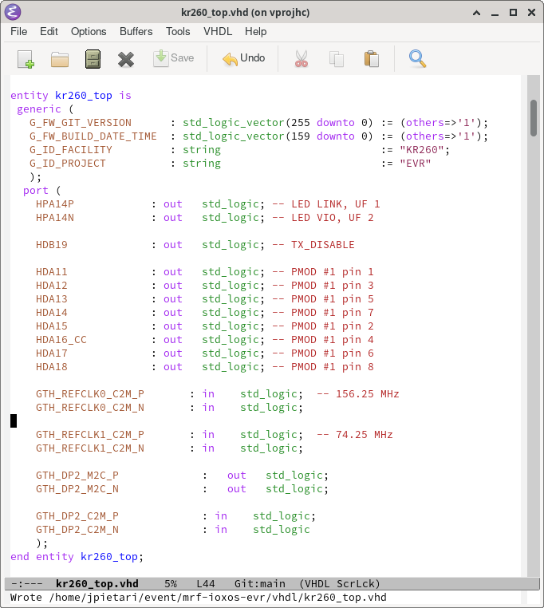
VHDL Board top level
Top level HDL (PL)
  I/O pins
  GTH reference clocks
  GTH RX/TX pins
I2C and other I/O goes through PS
  PS pins not present in PL design

Slide 11
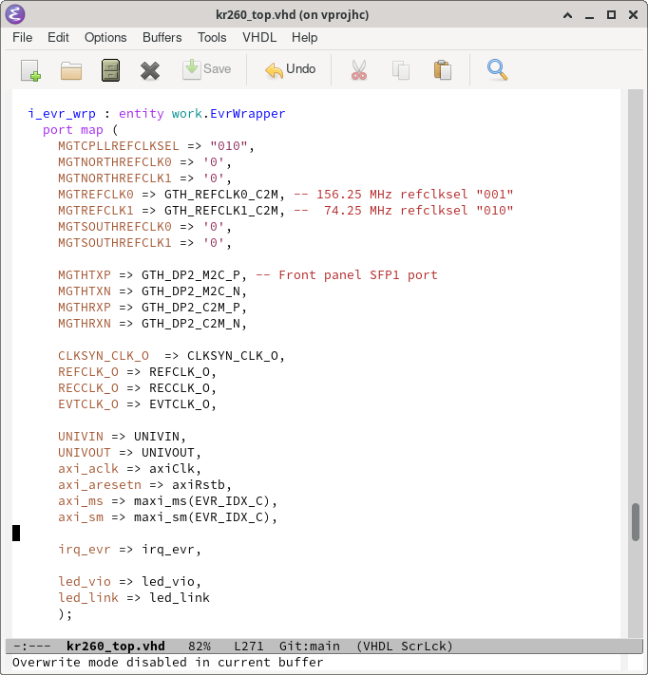
psi_common_axi_pkg
Part of psi_common library to enhance readability and unifying code through all files
psi_common_axi_pkg provides record types that groups AXI signals and keeps interconnections tidy
https://github.com/paulscherrerinstitute/psi_common

Slide 12
Linux PL_CLK issues
Recent Linux versions turn off unused clock coming from PS to PL side
Not an issue on Linux shipped with IFC_1414
2022.1 PetaLinux Starter Kit pre-built SD card image for KV260, KR260 seems to work

Slide 13
Linux Tools for Ultrascale+
I2C
  i2cdetect -y -a -r 1 for listing device on I2C bus 1
  i2cset -y 1 0x71 0x20 for writing 0x20 to device 0x71 on bus 1
  i2cset -y 1 0x76 0x06 0xbf for writing 0xbf to address 0x06 on device 0x76 on bus 1
  i2cdump -y 1 0x75 dump 256 registers on device 0x75 on bus 1
devmem
  devmem 0xa8000000 read 32 bit value at memory address 0xa800000
  devmem 0xa8000008 32 0x00000047 write 32 bit value to address 0xa8000000

Slide 14
Current Status of Ultrascale+ EVR Port
Started working in IFC_1414 but switched over to KR260
  Did not have FMC module for I/O
  IFC_1414 is missing scope probing points
  IFC_1414 has one green/red PL controlled LED in front panel
    Additional LEDs on PCB but difficult to see in crate
  KR260 has
    PMOD connectors for probing/additional LEDs
    Two fixed reference clocks for EVR
EVR visible from Linux through AXI (devmem)
Link is up, EVM shows round-trip delay
HW outputs on KR260 PMOD working
Delay compensation is not working
Missing clock cleaner

Slide 15
Licensing
Will be released open source
Software license MIT, BSD?

Slide 16
Acknowledgements
Till Straumann for his work on the CPSI_CIO Zynq Ultrascale+ port of the EVM for SLS-II
  Example of using TCL scripts for generating IP cores instead of using .xci files
  Introduction to the PSI AXI wrappers

